Slide 1
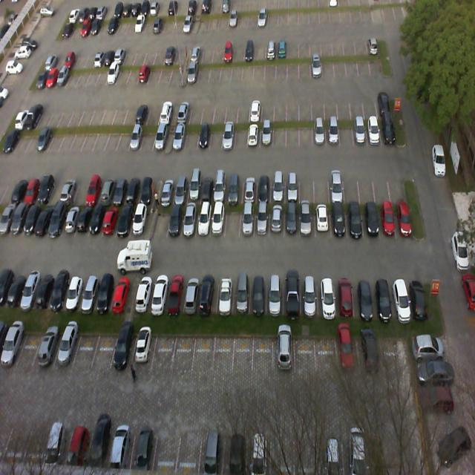
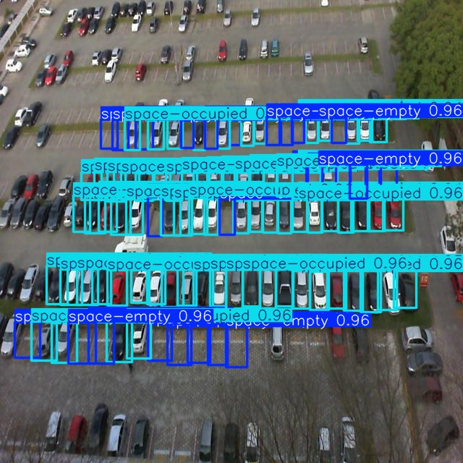
Yolov8 for parking lot occupancy

Slide 2
Project input
Project similar to the latest automatic inspection system project at work (SCHOTT AIS-XPV).
  Multiple detections in one image possible, marked with bounding box → YOLO model
  High speed detection of defects on glass products
  → YOLO v8

Slide 3
PKLot dataset
https://www.kaggle.com/datasets/ammarnassanalhajali/pklot-dataset
~12400 pictures from surveillance cameras of the same 3 parking lots.
Years 2012/2013, different weather, sunlight/shadows, lot occupations.
Labeling of a selection of the lots with roboflow is included.
Dataset is already split into train (8691), test (1242), val (2483)

Slide 4
Data preparation
Label structure from roboflow is not compatible with YOLO:
  One large JSON file had to be processed into a *.txt label file per image, containing all bounding boxes for the image.
  Bounding boxes are defined differently
  Category number is defined differently
  Additional label category file and folder structure was created manually

Slide 5
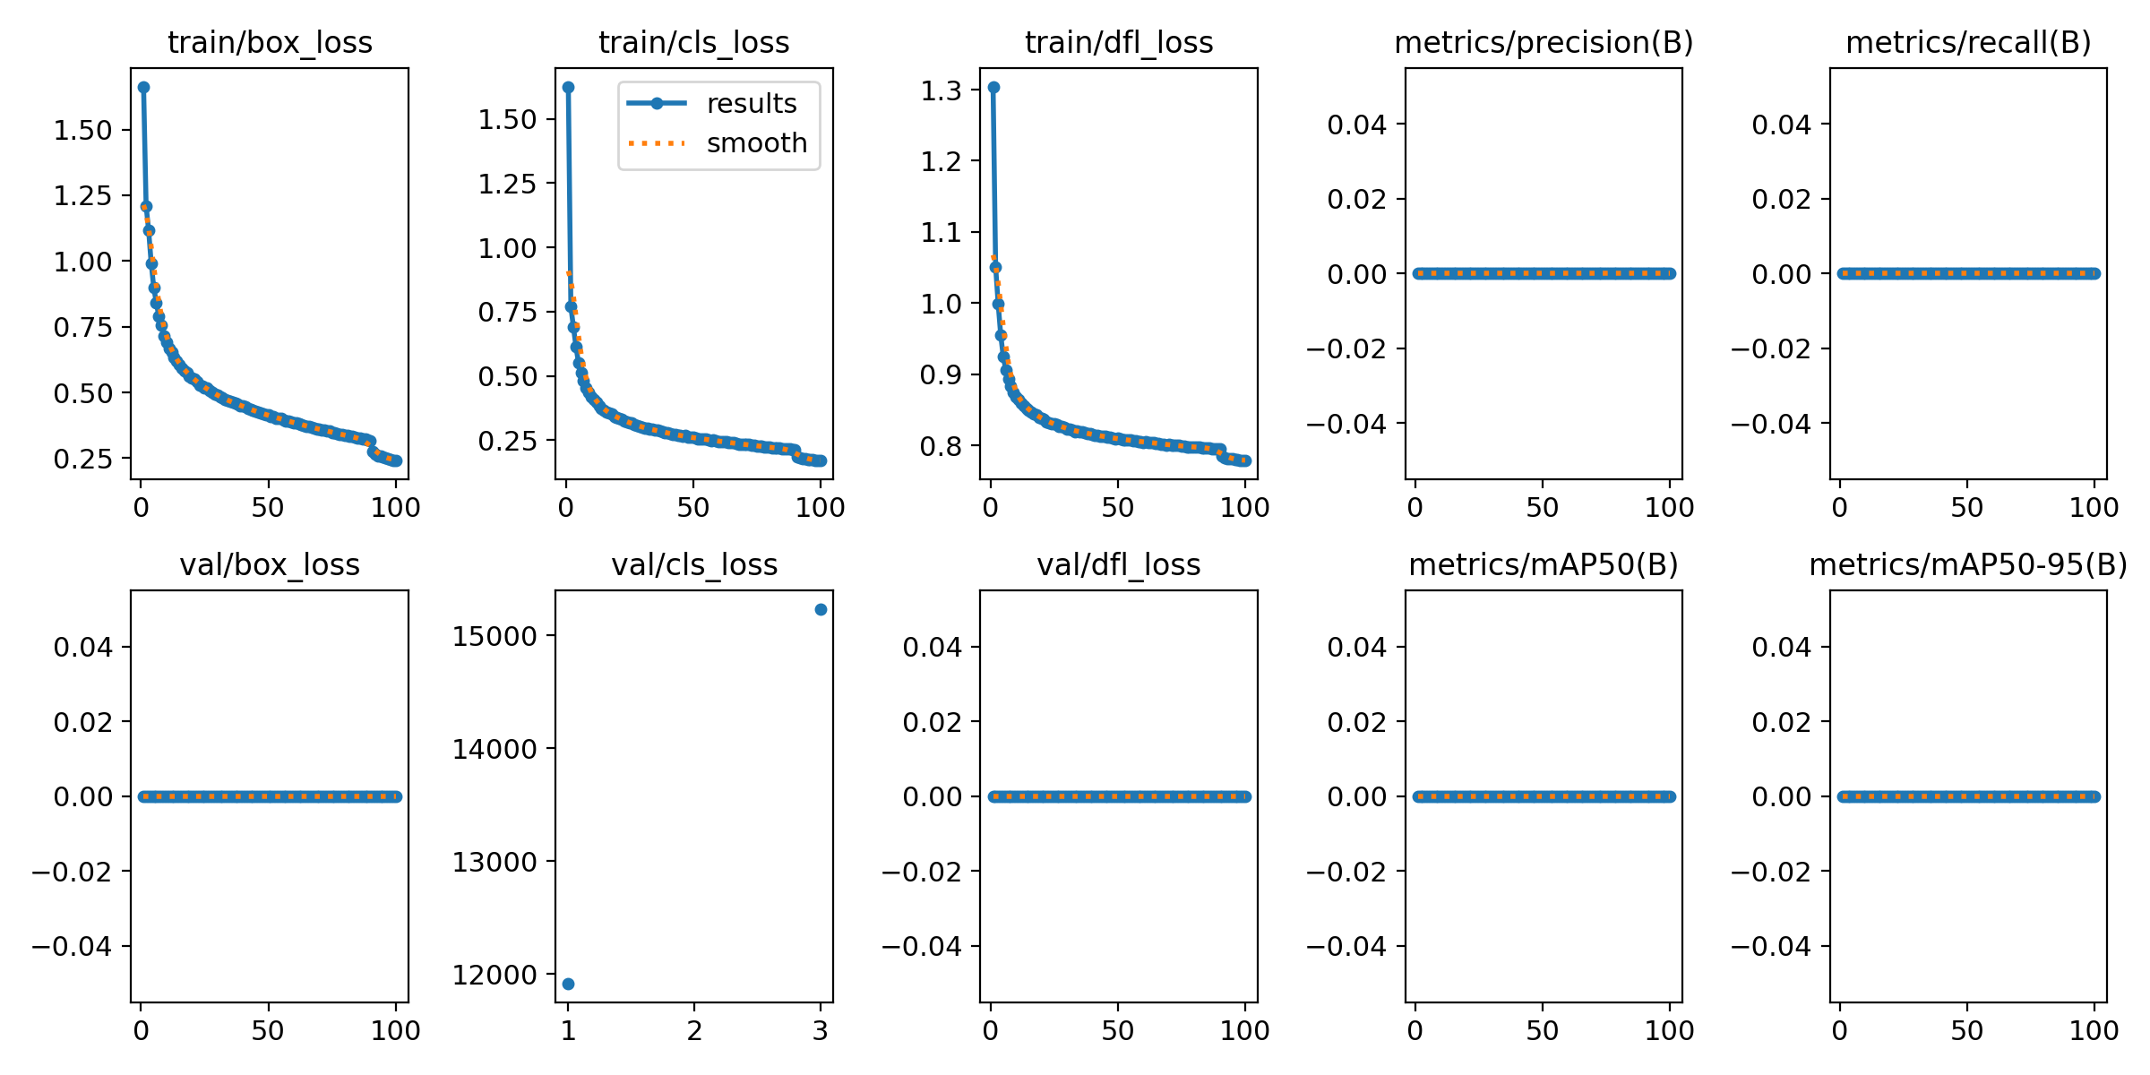
First successful training
First trial with 100 epochs

Slide 6
First training
Validation labels were missing.
Probably overfitting → 15 to 50 epochs might be enough.
Training took about 3 hrs.

Slide 7
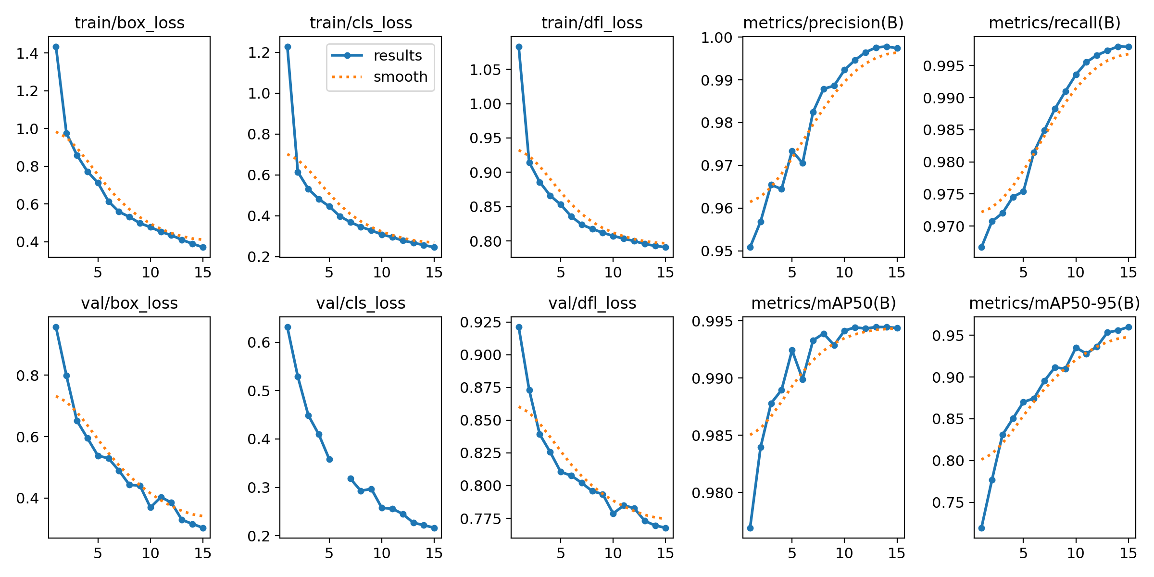
Second model
15 epochs

Slide 8
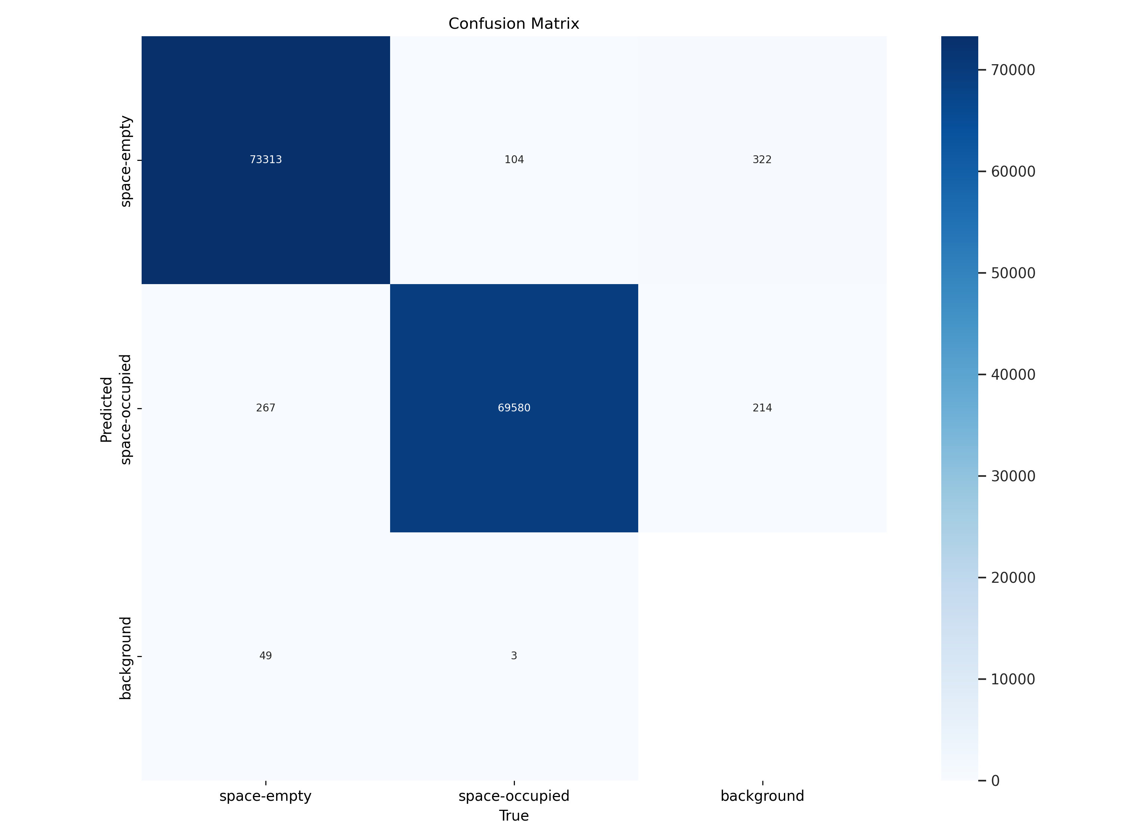

Slide 9
Second model
Many trials unsuccessful (Kernel died).
Location of lots seem to be really strict in the model → augmentation would probably break the locality, but maybe we don´t want that (counting free lots or total cars?).

Slide 10
Tipps
With Anaconda, use new env with only ipykernel installed, then pip install ultralytics in the env.
Only install other packages, if no up-/downgrades are necessary.
Disable second monitor.
Disable background processes.
Restart before execution.
Don´t do anything else with the computer.

Slide 11
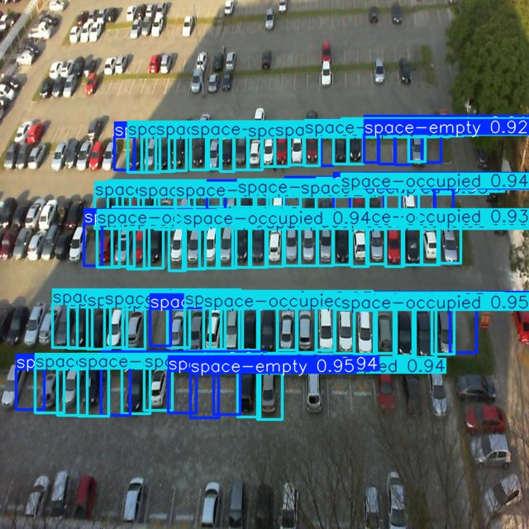
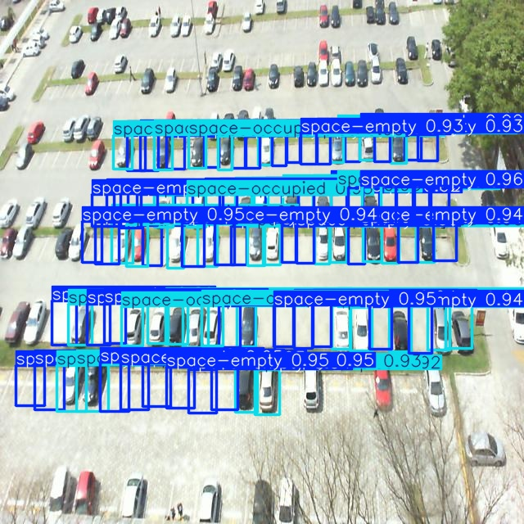

Slide 12
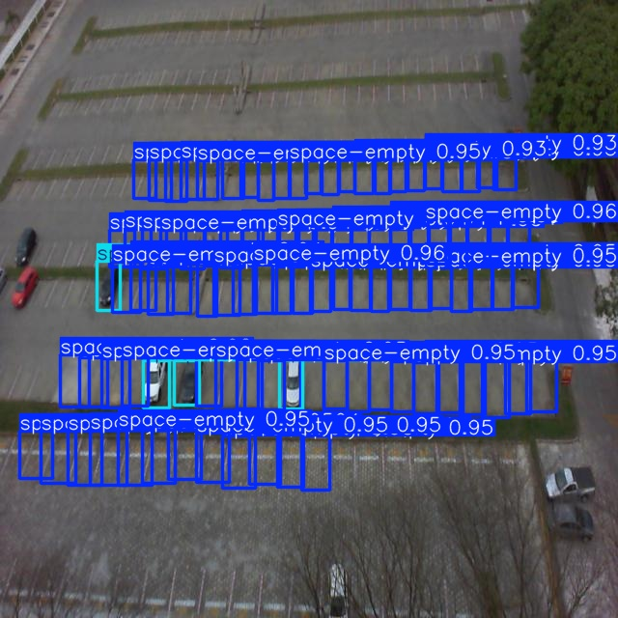
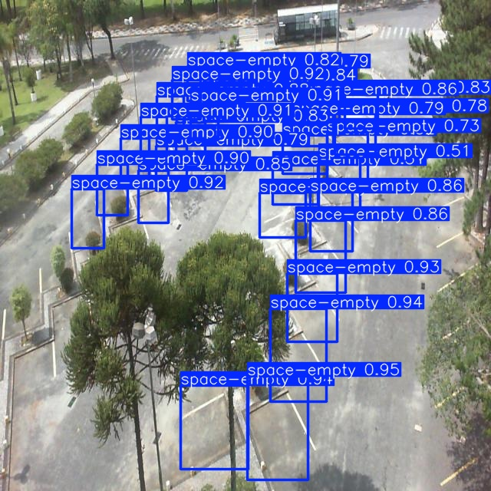

Slide 13


